Slide 1




NEXT GEN EMPLOYABILITY PROGRAM
Creating a future-ready workforce
Team Members
College Name
Student Name : Rahul B
Student ID :au951221104034
JP College Of Engineering

Slide 2

CAPSTONE PROJECT SHOWCASE
Project Title
Voting Web Application using Django Framework
Abstract | Problem Statement | Project Overview | Proposed Solution | Technology Used | Modelling & Results | Conclusion

Slide 3
Abstract
Developing a voting web application using the Django framework, aiming to provide a secure and user-friendly platform for conducting polls and surveys. Leveraging Django's robust features for authentication, data modeling, and template rendering to ensure scalability and efficiency. Implementing intuitive user interfaces for both administrators and participants, with features such as real-time result updates and data visualization. Integrating responsive design principles to ensure seamless usability across devices and browsers. Employing best practices for testing, deployment, and maintenance to deliver a reliable and sustainable voting solution.
Source :

Slide 4
Problem Statement
Accessibility: Ensuring the platform is accessible to diverse user demographics, including those with disabilities or limited technological literacy.
Trustworthiness: Establishing transparent and verifiable voting processes to foster trust among users and stakeholders, mitigating concerns about fraud or manipulation.
Community Engagement: Facilitating community involvement through interactive features such as discussion forums or feedback mechanisms, enhancing the democratic nature of the voting experience.
Data Privacy: Implementing stringent data privacy measures to protect user anonymity and confidentiality, complying with relevant regulations and standards.
Source :

Slide 5
Project Overview
The project aims to develop a secure and user-friendly platform for conducting online voting and surveys, utilizing the Django framework.
Key features include user authentication, intuitive interfaces for administrators and participants, real-time result updates, and data visualization.
The project leverages Django's robust features for backend development, HTML/CSS/JavaScript for frontend design, and possibly additional libraries or frameworks for enhanced functionality.
Upon completion, the project will deliver a scalable and reliable voting solution, prioritizing security, usability, and accessibility, suitable for various use cases such as elections, opinion polls, or feedback collection
Source :

Slide 6
Proposed Solution
User-Centric Design: Implementing a responsive and intuitive user interface to enhance engagement and ease of use, ensuring accessibility across various devices and screen sizes.
Robust Security Measures: Employing encryption techniques, secure authentication methods, and stringent data validation to safeguard user information and voting integrity, adhering to industry best practices and compliance standards.
Scalable Architecture: Designing a scalable backend architecture capable of handling increasing user traffic and data volume, utilizing cloud infrastructure and load balancing techniques to ensure optimal performance under varying loads.
Continuous Monitoring and Maintenance: Establishing a comprehensive monitoring system to track application performance.
.
Source :

Slide 7
Advantages
Enhanced Accessibility: By providing an online platform for voting, the application increases accessibility for individuals who may face barriers to physical polling stations, such as those with disabilities or mobility limitations.
Convenience and Efficiency: Users can conveniently participate in the voting process from anywhere with internet access, saving time and resources compared to traditional in-person voting methods.
Improved Transparency: The application fosters transparency in the voting process by providing real-time result updates and ensuring the integrity of the voting data, thereby enhancing trust and confidence among participants and stakeholders.
Scalability and Cost-Effectiveness: With a scalable architecture and cloud-based infrastructure, the application can easily accommodate fluctuations in user traffic and data volume, optimizing resource utilization and minimizing operational costs over time
Source :

Slide 8
Disadvantages:
Security Risks: Despite implementing robust security measures, online voting systems are vulnerable to cyberattacks, hacking attempts, and data breaches, potentially compromising the integrity and confidentiality of voting data.
Digital Divide: Not all individuals have equal access to the internet or digital devices, leading to disparities in participation and potentially excluding certain demographics from the voting process.
Trust Issues: Some users may have concerns about the reliability and trustworthiness of online voting systems, especially if they perceive the technology as unfamiliar or susceptible to manipulation, leading to skepticism and reluctance to participate.
Technical Challenges: Maintaining and updating the voting web application requires technical expertise and resources, including server maintenance, software updates, and troubleshooting, which can pose challenges for organizations with limited IT capabilities or budget constraints.
.
Source :

Slide 9



Technology Used
Frontend
Backend
Source :

Slide 10
Modelling & Results
Data Modeling: Implementing a robust data model to efficiently capture and manage voting-related information, including user profiles, voting options, ballot configurations, and voting results. This involves designing database schemas, relationships, and constraints to ensure data integrity and optimize performance.
Analytics and Reporting: Integrating analytical tools and reporting mechanisms to analyze voting trends, patterns, and demographics, providing valuable insights to administrators and stakeholders. This includes generating visualizations, charts, and reports to summarize voting outcomes and identify areas for improvement or further investigation.
Audit Trails: Implementing audit trail mechanisms to track and record all voting activities and changes to ensure transparency and accountability. This involves logging user actions, timestamps, and system events to facilitate auditing and forensic analysis in case of disputes or irregularities.
Result Verification: Implementing mechanisms for result verification and integrity checking to validate the accuracy and legitimacy of voting outcomes. This may involve cryptographic techniques, digital signatures, or third-party auditing to verify that the recorded votes match the actual preferences of participants and detect any tampering or manipulation attempts.
Source :

Slide 11
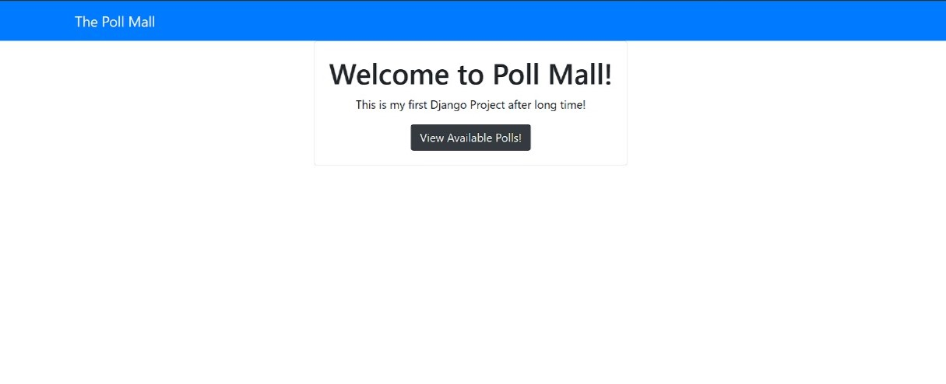
Homepage

Slide 12
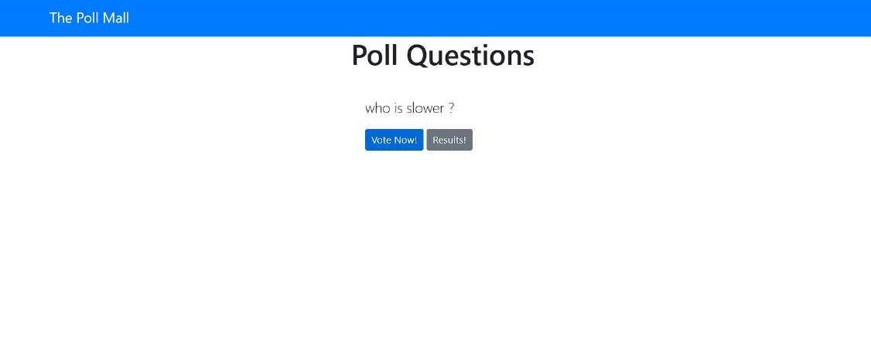
Polling questions page

Slide 13
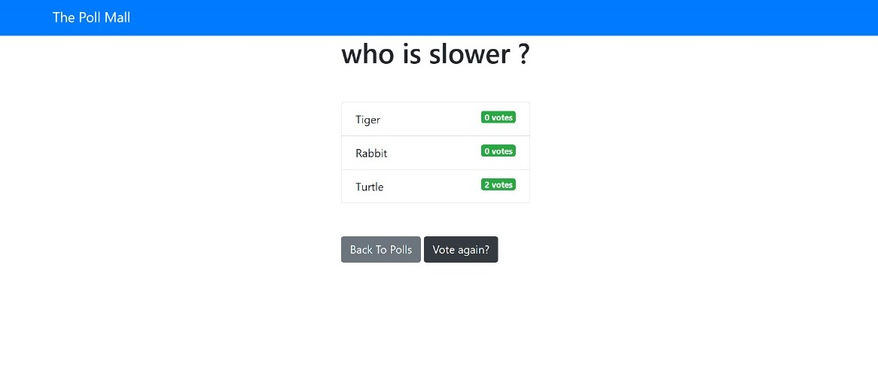
Voting page

Slide 14
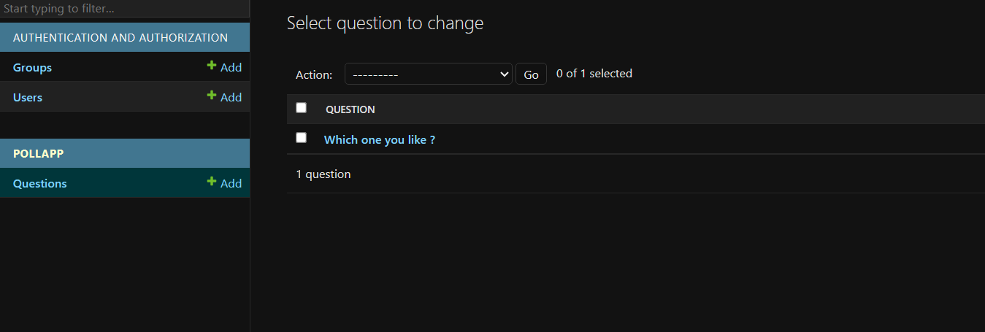
Admin Page

Slide 15
Future Enhancements:
Blockchain Integration: Explore integrating blockchain technology to enhance transparency, security, and immutability of voting records, providing a decentralized and tamper-proof ledger for storing and verifying voting transactions.
Enhanced Accessibility Features: Implement additional accessibility features such as screen reader compatibility, keyboard navigation, and language translation support to ensure inclusivity and accessibility for users with diverse needs and preferences.
Advanced Authentication Methods: Integrate biometric authentication methods such as fingerprint or facial recognition to enhance the security and user experience of the voting platform, reducing reliance on traditional password-based authentication.
Mobile Application Development: Develop dedicated mobile applications for iOS and Android platforms to offer a seamless and native voting experience on mobile devices, leveraging device-specific features and enhancing user engagement and convenience.

Slide 16
Conclusion
In conclusion, the development of a voting web application using the Django framework offers a promising solution to modernize and streamline the voting process. With its user-centric design, robust security measures, and scalability, the application aims to enhance accessibility, transparency, and efficiency in democratic practices. While challenges such as security risks and the digital divide remain, ongoing advancements in technology and continuous improvement efforts can address these concerns. By prioritizing user trust, technological innovation, and inclusivity, the voting web application holds significant potential to revolutionize democratic participation and decision-making processes in the digital age.
Source :

Slide 17
Thank You!
Notes:
Thank You !!

